Slide 1
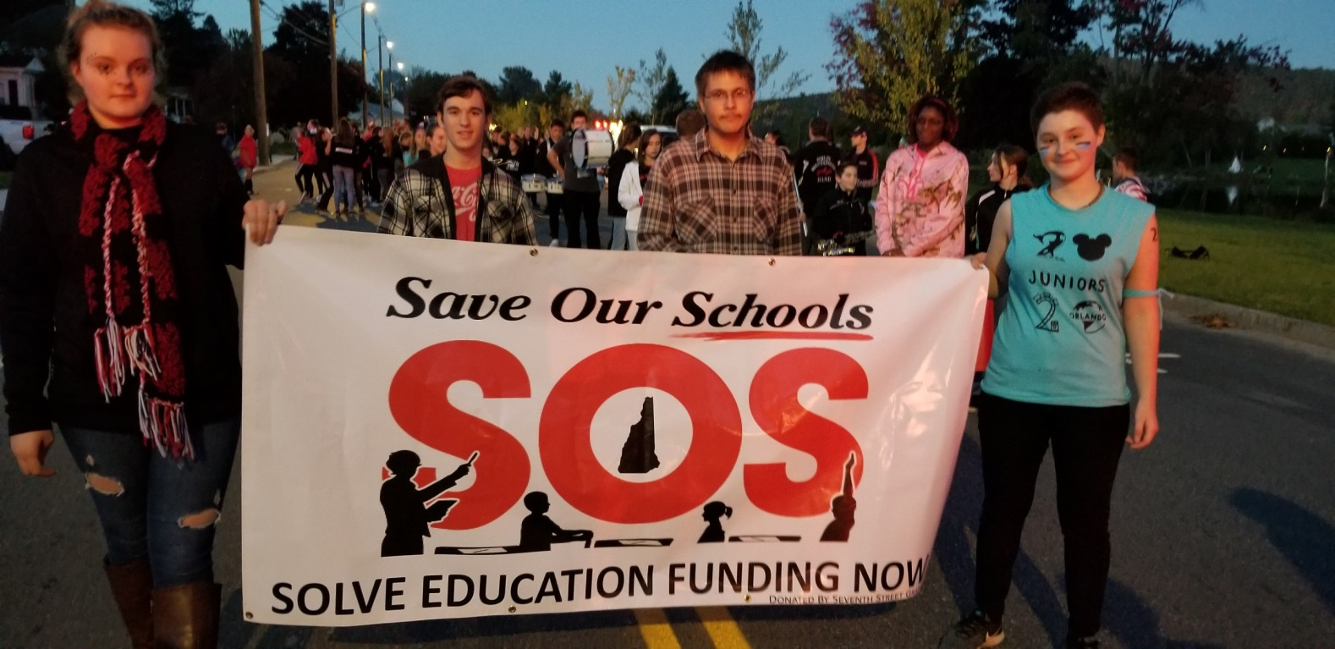
School Funding and Property Taxes
John D. Perkins Academy of Marlow
March 5, 2020
Presenters: John Tobin (jtobinjr@comcast.net),
Doug Hall (doughallnh@comcast.net),
Kent Hemingway (hemingway.k@gmail.com)
NH School Funding Fairness Project (www.fairfundingnh.org)

Slide 2
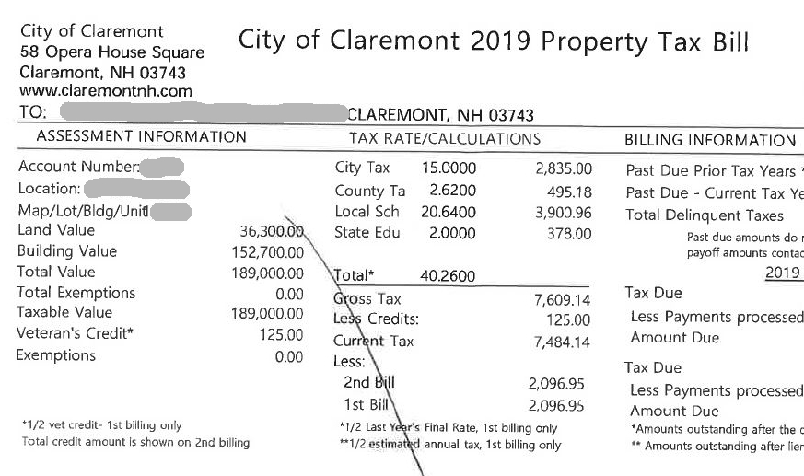

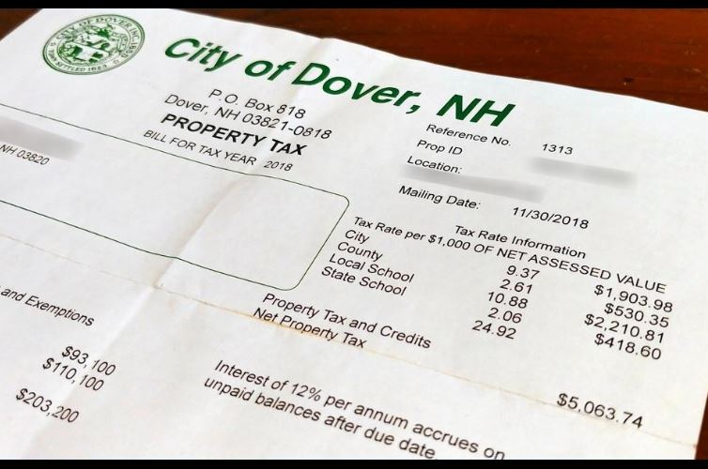
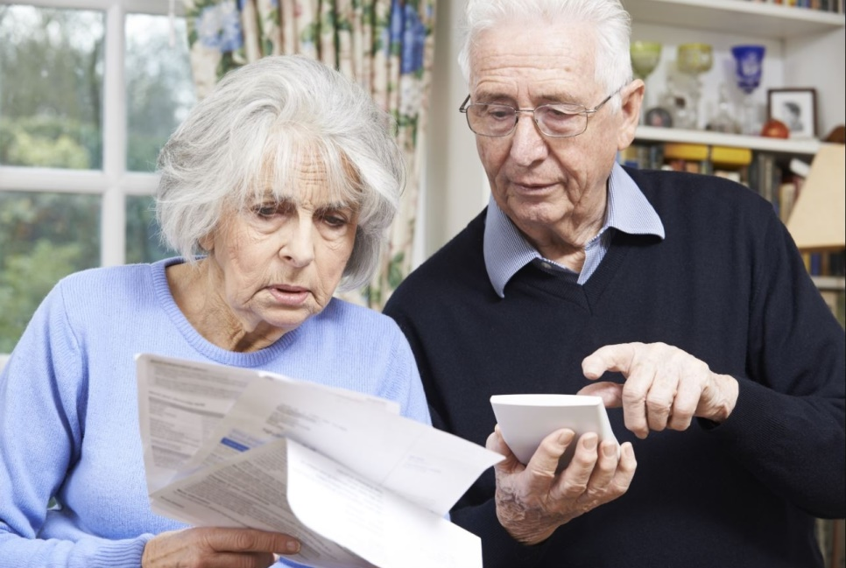
Local property taxpayers are feeling the pain

Slide 3
The Big Picture
Taxpayers and students are not treated equitably or fairly.
The problem is getting worse.
The current system is unconstitutional.

Slide 4
Two Supreme Court Decisions in the Claremont Cases
The State has a duty to pay for the cost of a constitutionally adequate education for every K-12 public school student.
The taxes that the State uses to pay for this education must have a uniform rate across the state.
Is the State meeting these requirements?

Slide 5
A Constitutionally Adequate Education –
A Broad Standard
“Given the complexities of our society today, the State's constitutional duty extends beyond mere reading, writing and arithmetic. It also includes broad educational opportunities needed in today's society to prepare citizens for their role as participants and as potential competitors in today's marketplace of ideas.”
(Claremont I)
138 N.H. 183, 192 (1993)

Slide 6
School Tax is Unjust
Claremont School Distr. V. Gov., 142 N.H. 462, 703 A.2d 1353 (1997) (Claremont II)
“…the present system of financing elementary and secondary public education in New Hampshire is unconstitutional. To hold otherwise would be to effectively conclude that it is reasonable, in discharging a State obligation, to tax property owners in one town or city as much as four times the amount taxed to others similarly situated in other towns or cities…precisely the kind of taxation and fiscal mischief from which the framers…took strong steps to protect our citizens.” 142 N.H. at 465.

Slide 7
The New Superior Court Decision in The ConVal Case
“The Court construes the fundamental right at issue as a right to the opportunity to a fully State-funded adequate education.”
Cheshire County Superior Court
Justice David Ruoff
June 5, 2019

Slide 8
The New Superior Court Decision in The ConVal Case
“RSA 198-40a II(a), the state statute that sets the cost of baseline adequacy (currently $3,636), is unconstitutional as applied to the petitioner school districts.”
Cheshire County Superior Court
Justice David Ruoff
June 5, 2019

Slide 11
Property Taxes and Other Largest NH Taxes in 2018
($ in millions)
Municipal
Local
School
$298

Slide 13
2008 to 2018: Change in School District Revenue

Slide 14
The key concept for
comparing school tax rates:
Equalized value per pupil
How much property value is available in a town to be taxed
to support each student’s education?

Slide 19
Equalized Property Value - Change 2007 - 2017

Slide 21
School Tax Rate Variations
Marlow and Its Neighbors
(Based on 2017-2018 Equalized Tax Rates)

Slide 22
Hanover and Some of Its Neighbors
District | Equalized Val/Pupil | Ed Tax Rate | Ed. Tax / $250,000 home | Elem. School Spending Per Pupil | Spending Gap x 20 Students
Hanover | $2,112,981 | $11.11 | $2,776 | $22,484
Canaan | $804,665 | $21.95 | $5,488 | $19,933* | -$51,020
Charlestown | $457,067 | $24.13 | $6,032 | $18,426** | -$81,160
Claremont | $422,632 | $24.08 | $6,020 | $16,917 | -$111,340
Enfield | $1,413,413 | $15.06 | $3,765 | $19,933* | -$51,020
Keene | $740,885 | $17.87 | $4,468 | $17,654 | -$96,600
Lebanon | $1,726,217 | $13.89 | $3,472 | $25,575 | +$61,820
Lyme | $1,292,344 | $17.06 | $4,265 | $23,185 | +$14,020
Marlow | $905,841 | $13.86 | $3,465 | $19,999 | -$49,700
 |  |  |  | *Mascoma Regional rate **Fall Mountain Regional rate

Slide 23
77% of Children Attend School in Communities with Below Average Equalized Property Values

Slide 24
Broad Consequences and Implications of Current School Funding System
(Lessons Learned from 70+ Local Forums)
Barrier to Economic Development (Discourages new businesses and business expansion in property-poor towns)
Works Against Attracting/Keeping Young Families; Discourages Workforce Housing
Discourages Regional Cooperation and Efficiency/Economies of Scale
Disparities Worsened by Uneven Burdens of Untaxable State/Federal Land and Current Use

Slide 25
State Adequacy Definition 2020
(Actual average cost per pupil in 2018-19: $16,346)
Marlow and surrounding towns

Slide 26
State Adequacy Definition 2020
(Actual average cost per pupil in 2018-19: $16,346)
Fall Mountain School District

Slide 27
What does an “Adequate” K-12 Education Cost ?
Let’s take an example:
The State of New Hampshire says that for Pittsfield’s 581 students an adequate education should cost $2,690,333
($4,630/student)
The Pittsfield School District budget for 2018-19 was $10,302,402
($17,732/student)
So let’s pare that budget down…..

Slide 28
Eliminate 5 of the 16 teachers at the elementary school
Eliminate all art, music, and physical education classes in all grades
Eliminate all school nurses and any medical support
Eliminate all regular and special education transportation services (parents to transport their children to and from school)
Eliminate one of the two office secretaries at the elementary school
Eliminate one of the two office secretaries at the middle/high school
Eliminate teachers for business ed, family & consumer science, and health
Eliminate one of four science teachers at the middle/high school, thus eliminating some labs and electives
Eliminate all building and grounds maintenance and repairs
Eliminate student participation in Concord Regional Technical Center classes
Eliminate all foreign language courses
Eliminate both counselor/behavioral professionals and support staff
Eliminate four of eight custodians: building cleaning only twice per week
Eliminate health insurance and other benefits in current teacher contract
Eliminate all field trips
Eliminate all athletic programs: soccer, basketball, softball, and baseball
Eliminate the district reading specialist
Eliminate 34½ paraprofessional positions, including special ed teacher aides
Eliminate purchase of equipment, supplies, books, subscriptions, technology
Eliminate ESOL program (English for speakers of other languages)

Slide 29
Eliminate all substitute teachers, thus requiring students to be dismissed
Eliminate three special education teachers
Eliminate provisions for teacher development courses, workshops
Eliminate mentor teachers who support new teachers
Eliminate all technology personnel, equipment, training, software, etc.
Eliminate consulting specialists such as vision specialists and psychologists
Eliminate travel reimbursement for training events, meetings, home visits, etc.
Eliminate all co-curricular programs (clubs, activities, student council, etc.)
Eliminate the summer recreation program
Eliminate all guidance personnel
Eliminate substance abuse counselor
Eliminate speech/language, PT, OT, and vision services for special needs students
Eliminate stipend for teachers’ summertime work on innovation and development
Eliminate stipends for teacher leaders
Eliminate all librarians and media center staff and close media centers
Eliminate school board stipends
Eliminate school board expenses, including lawyers and auditing services
Reduce time of superintendent to one day per week
Eliminate all photocopiers and their supplies
Eliminate maintenance of athletic field
Eliminate one school principal, leaving only one for both school buildings
Eliminate all office incidentals: postage, supplies, advertising, etc.

Slide 30
With the above reductions
Most “core” K-12 classrooms are maintained
Class size averages 29 students/teacher
Budget is now $5,289,610
Now cut to the State’s “adequacy” level of $2,690,333
Nearly everything else has been eliminated so now eliminate nearly half of the remaining teachers
Class size averages 60 students/teacher
How does anyone believe that this will provide an adequate education for Pittsfield’s 581 students?

Slide 31
Comparing Starting Teacher Salaries
Starting teachers in Pittsfield, etc., might earn $15,000 more elsewhere. This causes high teacher turnover

Slide 33
SWEPT
(StateWide Education Property Tax)
Set by law: $363 million
Municipalities collect the SWEPT and send the total amounts collected directly to their school districts. SWEPT money is never transferred to the State
SWEPT does not reduce disparities among school districts
It is part of the local tax that has been renamed.
Average SWEPT tax rate was $2.17 for 2016-17. For 2017-18 it was $2.06.

Slide 34
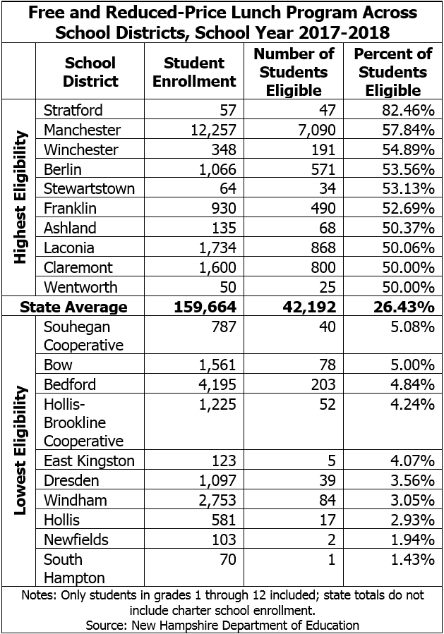


Slide 35
NH School Funding Fairness Project
Informing the Public & Advocating for Change
More than 75 community presentations across the state since June 2018;
Grassroots organizing, building on the forums
Research and analysis – documenting the inequities and harm;
Legislative advocacy;
Media outreach (traditional and social media);
Legal advocacy

Slide 36
Goals & Results:
2019 Legislative Session
Immediate – Restore “Stabilization Aid” to 2012 levels, as of July 1, 2019. Achieved - included in the final budget.
Medium Term – Increase base state aid per pupil to $7,500. NOT ACHIEVED. But new Disparity Aid - included in the final budget (for one year only).
Long Term – Establish an independent and fully funded Commission to recommend new adequacy/cost standards and funding system. Achieved – included in the final budget and has begun work.

Slide 37
Next Steps
An Amicus Brief in ConVal Case -
On behalf of multiple school districts
Monitoring and assisting the new Commission on School Funding
Another Lawsuit Possible;
Keeping the pressure on the legislature and Governor;
5 year complete public campaign;
Community forums, newsletters, advocates,
social media, op-eds: Full speed ahead

Slide 38
What You Can Do!
Write a letter to the editor about this issue;
Post comments and links about this issue on Facebook and other social media;
Talk to your Legislators about finally fixing this problem.
Tell your friends and family members about what you have learned;
Before the election, repeat 1-4 and set up a legislative candidate forum in your town.

Slide 39
A Final Thought
A New Hampshire student’s educational opportunities –and a property owner’s school tax rate - should not depend on their zip code.

Slide 40
Questions?

Slide 41
